Slide 1
Franciscan Youth and Young Adult “Four Core” Training Session 1: Our Mission to Young People
Slide 1

Slide 2
Slide 2
Inspired by the life of St. Francis of Assisi
and guided by our OFS Rule (Art. 24) and
General Constitutions (Art. 96 & 97)...

Slide 3
Slide 3
Our Mission
is to bring the gospel
of the Lord Jesus Christ
to the youth and young adults
of the United States of America.

Slide 4
Slide 4
We are called to share this Franciscan way of life through
prayer, formation,
and social justice action
with all youth
whom we encounter.

Slide 5
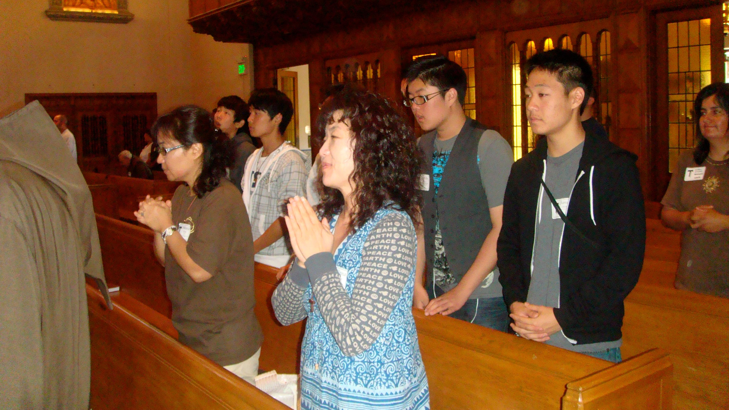
Slide 5
Prayer

Slide 6
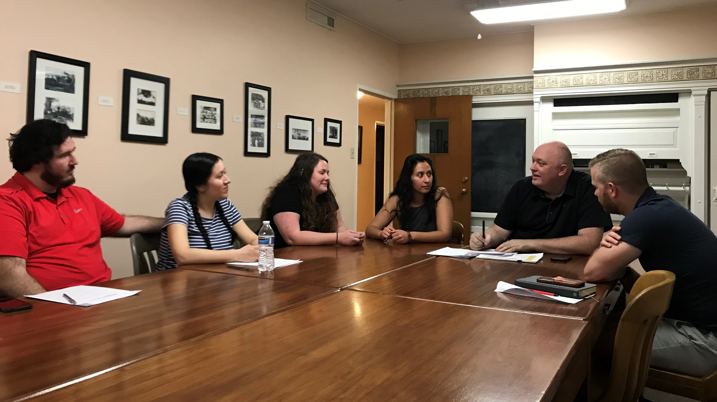
Slide 6
Formation

Slide 7
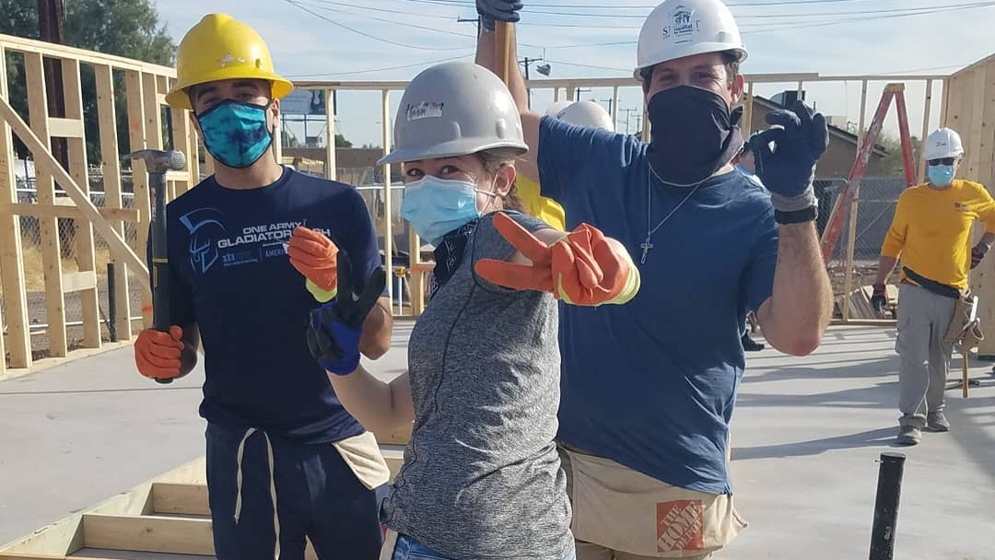
Slide 7
Social Justice Action

Slide 8
Slide 8
We envision journeying with youth and young adults, to:
Discern their purpose in life and
2) Develop a relationship with Jesus Christ.

Slide 9
Slide 9
After experiencing fraternal life, these young people may desire to form a YouFra community.

Slide 10
Slide 10
And if they choose
to form a YouFra,
the OFS at all levels commits to support them.

Slide 11
Slide 11
The commission will…
Provide the necessary training and resources to aid
OFS fraternities in their outreach to youth and young adults and in the formation of YouFra groups,

Slide 12
Slide 12
...being sensitive to differences in culture, settings, and environments.

Slide 13
Slide 13
…provide networking opportunities between the national executive council,
the commission,
local and regional fraternities, Franciscan Youth and Young Adults and YouFra worldwide.

Slide 14
Slide 14
...introduce Catholic and other interested young people in the United States to Sts. Francis and Clare of Assisi.

Slide 15
Slide 15
Share with young people the connection between the Gospel of Jesus and the Franciscan spirituality
and way of life.

Slide 16
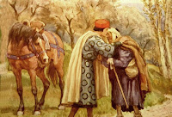
This Photo by Unknown Author is licensed under CC BY-SA
May God bless the work of your hands!

