Slide 1
What is Youth Ministry?
Youth and Young Adult Commission National Fraternity of Secular Franciscan Order – U.S.A.

Slide 2
1
When we speak of youth, we refer to any child under age 18. Do you have a relationship with a young person under 18? What is the relationship? (Friend, child, grandchild, student, etc.?)
“A child needs love and support either from their home life or a mentor outside of their home. It’s best if they have both, but they won’t survive well
if they don’t have one or the other.”
share

Slide 3
Who are Our Youth?
2
Youth 14-18
To work with youth under 18 years, remember you must follow all diocesan requirements and...
Be officially certified with whatever Safe Environment program your diocese uses.
Some groups are working with even younger children, sometimes called “Little Flowers of Francis or NiFra”(4-9) or “Friends of Francis.” (10-14)

Slide 4
What is Youth Ministry?
3
Youth Ministry is the response of the Christian community to the needs of youth, and the sharing of the unique gifts of youth with the larger community.
A Vision of Youth Ministry United States Conference of Catholic Bishops

Slide 5
What is Youth Ministry?
4
Youth Ministry is to youth – responding to youth’s varied needs.
Youth Ministry is with youth – working with adults to fulfill their common responsibility for the Church’s mission.
Youth Ministry is by youth – exercising their own ministry to others: peers, community, and world.
Youth Ministry is for youth – interpreting the needs of youth, especially in areas of injustice and acting on behalf of or with youth for a change in the systems which create injustice.
A Vision of Youth Ministry United States Conference of Catholic Bishops

Slide 6
What are the Goals of Youth Ministry?
5
Goal One: To empower young people to live as disciples of Jesus Christ in our World today.
Goal Two: To draw young people to responsible participation in the life, mission, and work of the Catholic faith community.
Goal Three: To foster the total personal and spiritual growth of each young person. (CIOFS: human, Christian, and Franciscan)
Renewing the Vision: A Framework for Catholic Youth Ministry United States Conference of Catholic Bishops

Slide 7
What are the Components of Youth Ministry?
6
Ministry of Advocacy
Ministry of Catechesis
Ministry of Community Life
Ministry of Evangelization
Ministry of Justice and Service
Ministry of Leadership Development
Ministry of Pastoral Care
Ministry of Prayer & Worship

Slide 8
What elements should be contained in youth programming?
7
Effective catechesis follows the way of Jesus when it engages the head (the cognitive or believing part of the person), the heart (the trusting or affective part, and the hands and feet (the doing or active part).
National Director for Catechesis United States Conference of Catholic Bishops

Slide 9
What are the Themes of Youth Ministry?
8
Developmentally Appropriate
Family Friendly
Intergenerational
Multicultural
Community-Wide Collaboration
Leadership
Flexible and Adaptable Programming

Slide 10
What do we mean by “Flexible and Adaptable Programming?”
9
A diversity of program settings,
Age-specific programs for young and older adolescents.
Family-centered programs for the entire family , for parents, for grandparents raising children, adolescents, etc…
Small-groups programs and small ecclesial community experiences.
Home-based programs, activities, and resources.
One-on-One and mentoring programs and activities.
Independent or self-directed programs.
A variety of scheduling options and program settings to respond to the reality of the busy lives and commitments of adolescents and their families.
Use of current technology to facilitate communication in program development and implementation.

Slide 11
A New Approach
10
Old Method
Emmaus Method
Teach the rules first.
If they obey the rules, they will be accepted into the group.
They are invited in, but their sense of belonging is dependent on how successfully they follow the rules.
Invite them in and help them feel accepted where they are in their journey.
They grow in their desire to belong to the community of love.
They gain a respect for and an understanding of the “rules,” or what it means to follow a Gospel life. They are drawn to it, and know we are all on a journey, and that they will be supported and forgiven when they fail.

Slide 12
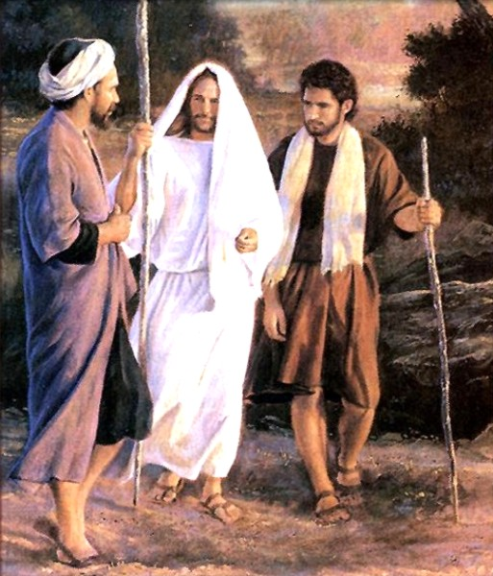
A Guiding Image for Ministry with Adolescents?
11
“To be effective ministers we will first, like Jesus, join people in their daily concerns and walk side by side with them on the pathway of life.
We will ask them questions and listen attentively as they speak of their joys, hopes, griefs, and anxieties.
We will share with them the living word of God, which can touch their hearts and minds and unfold the deep meaning of their experience in the light of all that Jesus said and did.
We will trust the capacity of prayer and sacrament to open their eyes to the presence and love of Christ.
We will invite them to live and share this Good News in the world.”

Slide 13
12
“While age and experience can be important to transmit faith and guide a young person, the Holy Spirit speaks through the wisdom of youth and young adults themselves. This cannot be overlooked. Recognizing that what young people say, can provide some light to help the Church better understand the Gospel.
When we journey together, we can learn from one another, warm hearts, inspire minds,
and lend new strength to our hands.”
Listen, Teach Send quoting Christus Vivit

Slide 14
13
“There remains a great need in the Church’s ministries with youth and young adults for more women and men within faith communities to step up and be willing to ‘put out into the deep’ (Lk 5:4) for the sake of the young.”
Listen, Teach, Send quoting JPII Novo Mellenio Inuente)

Slide 15
CLOSING PRAYER
14

