Slide 1
LISTENING
JEAN A. D’ONOFRIO, OFS
NAFRA FYYA COMMITTEE
ANIMATOR TRAINING
SEPTEMBER, 2020
Notes:
Peace and Good !! My name is Jean D’Onofrio, and I’ve been a professed Secular Franciscan since 1997. Along my Franciscan journey, one of the tools that the Lord has helped me to learn has been that of being a good listener. Those who know me well, will say that I am still in the process of learning that !
However, before we can presume to really HEAR our young adults, each other, and our inner selves, I would like to start this session with some exploration in listening to our good and gracious God.

Slide 2
1Samuel 3:7-9 NAB At that time Samuel was not familiar with the Lord, because the Lord had not revealed anything to him as yet. The Lord called Samuel again, for the third time. Getting up and going to Eli, he said, “Here I am. You called me.” Then Eli understood that the Lord was calling the youth. So he said to Samuel, “Go to sleep, and if you are called, reply, ‘Speak, Lord, for your servant is listening.’”
How is the Lord calling you today?
Notes:
As with all things I’d like to start, as Francis did, listening to God in the Scriptures and then sitting with that quietly to hear with our hearts. There is so much cacophony that surrounds us in our daily lives, compounded by the noise in our heads as we sift through conflicts and negativity, that it is no wonder how difficult it is for us to be still and listen the One who loves us more than we can ever imagine. As the Lord has been speaking to us since Creation, let’s look at two Scriptural verses taken from the Hebrew Scriptures. The first is from 1Samuel….( slide)

Slide 3
1 Kings 19: 11-13 NAB Then the Lord said, “Go outside and stand on the mountain before the Lord; the Lord will passing by.” A strong and heavy wind was rending the mountains and crushing rocks before the Lord– but the Lord was not in the wind. After the wind, there was an earthquake—but the Lord was not in the earthquake. After the earthquake there was fire –but the Lord was not in the fire. After the fire there was a tiny whispering sound. When he heard this, Elijah hid his face in his cloak and went and stood at the entrance of the cave. A voice said to him, “Elijah, why are you here?”
How/Where do you hear the Lord? With whom do you discern the Lord’s voice/
1
Notes:
The second is from 1 Kings…..

Slide 4
At our deepest core, we long to hear the words that came from the Spirit as the clouds opened that day at the Jordan River, when John baptized Jesus– “ You are my beloved, with whom I am well pleased” ( Matt. 3:16-17 paraphrasing is mine).
Notes:
At our deepest core, we long to hear the words that came from the Spirit as the clouds opened that day at the Jordan River, when John baptized Jesus– “ You are my beloved, with whom I am well pleased” ( Matt. 3:16-17 paraphrasing is mine).

Slide 5
Notes:
This daughter/son –ship is not earned, rather it is freely given to us by this loving Creator who cannot but love, and who longs to meet us and speak words of love to each of us, not because of anything we have or have not done, just because our creator God LOVES!– and we are each the chosen one with whom intimate relationship is offered. St. Francis roamed the world in awe of this, saying– “ My God, Who are You, that you love me so much? And, who am I, that you do?” We need to listen to God speaking to us, before we can listen the God present in the person before me.
So, how do we learn this language of intimacy to truly hear and listen? With practice! And with a trusted one who is perhaps two steps ahead of you on the journey.
For the next 5 minutes I invite us to enter in and be present in this time and place and take a rest in the heart of our good and gracious God.
I invite you to pick a piece of meditative music, words or no words, ( I like David Hass’ Peace Prayer and it is on Youtube, or you could use Blest are they,the poor in spirit also by David Haas,,substituting in your head your own name instead of the word they). When the music is over, set a timer for 2 min. and just be still in God’s presence. May this gift of listening time be blest !

Slide 6
RESPECTFUL COMMUNICATIONS GUIDELINES
R – take RESPONSIBILITY for what you say and feel without blaming others
E- use EMPATHETIC listening
S- be SENSITIVE to differences in communication styles
P-PONDER what you hear and feel before you speak
E- EXAMINE you own assumptions and perceptions
C- keep CONFIDENTIALITY
T-TRUST ambiguity because we are not here to debate who is right or wrong
Notes:
I will trust that these 5 minutes were blest for you. Now, to look at how in our daily lives we are presented with challenging opportunities in which we are confronted with possible diverse positions on a variety of topics. The challenge is to allow speakers to express the position they hold using Respectful Dialogue Guidelines. These were first presented for use in the small group fraternities at one our Quinquennials ( the every 5 year National gathering of our Secular Franciscans with invited guests from International CIOFS as well as our beloved Spiritual Assistants from the First, Second, and Third Orders). They have been a wonderful addition for use in our local fraternities as well as fostering improved communication skills for daily life.

Slide 7
Difficult Topics Listening Exercise
For this exercise: Pick one of the suggested questions. One person will take one side of the argument and present for 2 ½ min., while the listener just listens without comments or disputes.
What is the proper way for the toilet paper to roll, from the back or front?
Who had it harder during the COVID-19 “shutdown” days? The essential front line workers, or those at home?
Is it less of a carbon footprint to buy clothes made in USA or China?
Should a couple who is living together prior to marriage receive the Sacrament of Matrimony in Church?
At the end of the exercise you could take some time together to share your experience/ frustrations/ insights.
Notes:
The Difficult Topics Exercise is presented as an application of respectful dialogue engaging with a partner, giving each one time to “present” one side of the position, while the other just listens, not offering rebuttals, nor challenges, nor corrections. This is not as easy as it appears, ass we seem to be naturally drawn to justify our “correct” position, or point out the inadequacies in the other’s arguments, or become highly judgmental and defensive. The challenge is can we just listen !
In planning the overall presentation, this was envisioned to be a partner exercise; therefore, perhaps you might like to practice this with someone at another time.

Slide 8
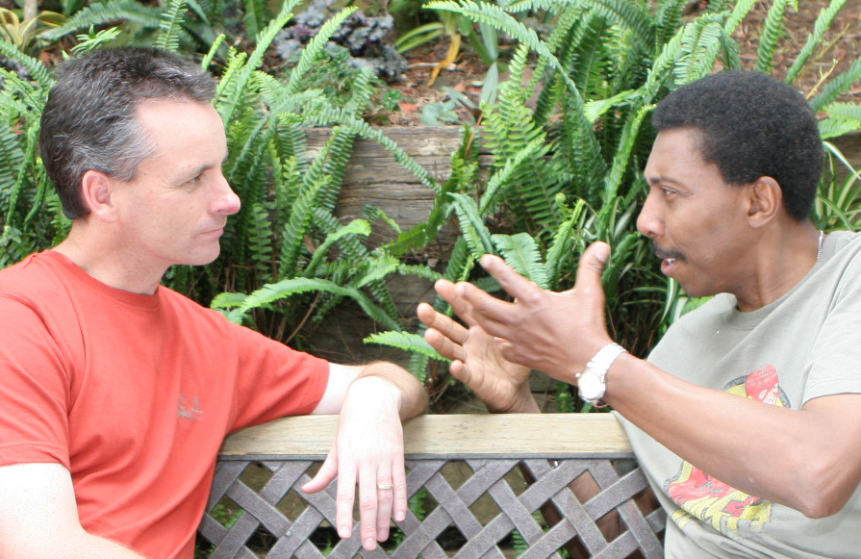
We all have a desire to be truly heard, have our lives validated, have someone care about what we are going thru, and know that we are not alone.
Notes:
slide .. And when we try to communicate there are so many ways that our words can be misconstrued ! The words which come out of our mouth have to go thru another’s ear which may have some physical diminishment of hearing, thru a brain which has its own unique hard-wiring, and processing, and by the time the spoken word has gone thru all this, what the listener hears may not be what the speaker actually wanted to convey with the spoken words that came out of his/her mouth!

Slide 9
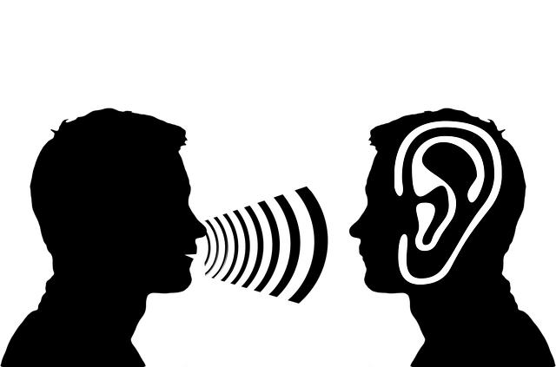
What you heard may not be what I wanted to convey. Furthermore, it may not be what I think I said!!!!
Notes:
Slide ..
Between the brain of the speaker and what comes out of the speaker’s mouth and enters into the listener’s ear as sound waves there is sometimes a disconnect at the speaker’s end of a conversation. Then, what physiologically the listener hears, and what the listener’s brain discerns ( sometimes jumping to a conclusion without first really hearing the entire sentence), could be an entirely different statement than what the speaker actually wanted to say !!

Slide 10
Some questions for personal reflection:
Who really listens to you today? What do you most value as they hear you?
What are the successful strategies or efforts that they use to listen to you?
Conversely, whom do you most want to really listen to you and what are some unsuccessful strategies or efforts that you have used to obtain this person’s attention and understanding?
How can you practice sharing your feelings and needs directly?
Notes:
This was envisioned to be a two person exercise; however, take 2 minutes to process these, and if possible, share your answers with another person, if not jot down your answers. If you can share with another, each person gets 90 seconds to share. That’s it- just share, no time to give advice! Just LISTEN! READ SLIDE

Slide 11
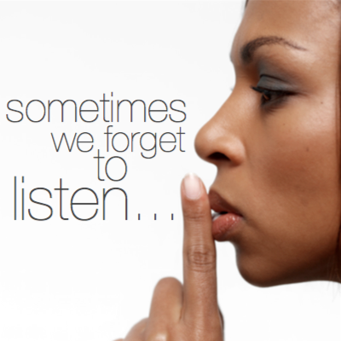
Reflective Listening
Notes:
From the foundation of hearing our God, and having reflected on some personal experiences of being heard, or not, and knowing for ourselves the importance of being heard, we continue.
Unfortunately, most of what occurs when we share our hurts and pains ends up being either “ I told you so”, “ That wasn’t so bad”, “ Hey, I have it worse”, “ Oh, that’s nothing, a year ago this happened to me”, “ You know, you could fix that situation if you changed what you are doing wrong”.
I would like now to explore some techniques for Reflective/ Active/ Empathetic Listening.
The material is from a Rockville Centre Diocesan Catholic Health Services program for Spiritual Care Companions which I completed in 2011. Much of it was written by Carol Cella who actively presents workshops on this topic and has currently has published the workshop in book form. She can be reached at www.embracecaretaking.com if you are interested in more information on this topic, to sign up for her monthly blog or to request her to present workshops.

Slide 12
REFLECTIVE LISTENING:
LETS THE OTHER REALIZE THAT HE/SHE WAS HEARD AND UNDERSTOOD,
CARED FOR AND SUPPORTED,
HAS BEEN GIVEN TIME AND A SAFE PLACE TO VENT, SORT OUT ISSUES, THINK AND ARTICULATE MORE CLEARLY,
AND EXPRESS THEIR FEELINGS.
MOST IMPORTANTLY, WE HELPS THE OTHER TO ARRIVE AT A SOLUTION TO ONE’S OWN PROBLEM
Notes:
Reflective Listening is useful to create a climate of warmth and welcome. It is helpful when another is experiencing a difficulty or problem. It is a way to handle another’s anger or resistance, or to settle disputes or to conduct a difficult conversation with another. Giving feedback by reiterating what was said helps the listener check for accuracy. Reflective listening ….Read Slide..
Looking at the last bullet item, for me this was the key! I am a “Fixer” by nature, and as a physical therapist, also by profession. My inclination is to SOLVE the PROBLEM !! Yet, my words are not what are needed at the moment that a young adult is pouring out their anger, or sadness. AND, by allowing the person to share their depths, we actually help to unlock the Spirit within them so the speaker can delve deeper within to hear the Spirit within and hopefully access the answer that , perhaps, they already know, within themselves ! Once I realized that the better listener I can be, the better I can help fix the problem. A bit oxymoronic, but for me that was the key!

Slide 13
Notes:
We want to follow the thoughts and feelings of another to understand what the other is saying from his/her perspective. When we listen reflectively, we pay respectful attention to the content and feelings expressed in another's communication’ that is, hearing and understanding and then letting the other know that they are being heard and understood. Starting with our non-verbal behavior, we want to actively engage with proper eye contact, facial expressions, calm voice and body positioning. Keeping the focus your attention on the other’s need, not your perspective can be difficult. By not jumping in we allow time for thought, and the Holy Spirit !!

Slide 14
. We are blest when we take the time to listen
to difficult (both emotionally and physically) speech ---
for we help the speaker to know that, in the process, they can be understood and loved.

Slide 15
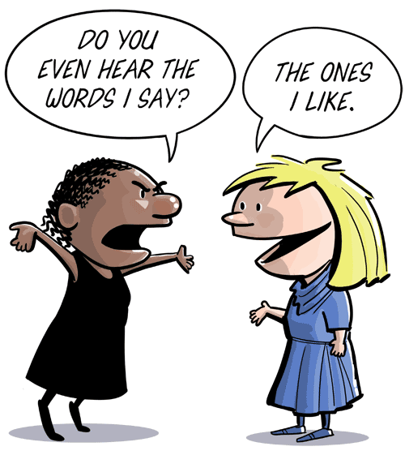
Notes:
Keeping the focus of your attention on the other’s need, not your perspective can be difficult. By not jumping in with what we “need” to say, we allow time for thought,
and, the Holy Spirit.

Slide 16
Notes:
The Active Listener sees the world,, the situation and the experience as the speaker sees them and shows interest and concern, is attentive, and encourages the other to speak freely. Understanding is placed ahead of evaluation. The Active Listener does not anticipate what the other is going to say!
A great deal of patience is needed, as most people are used to instant responses and judgments. There is acceptance of the speaker. The speaker’s feelings, opinions or attitudes are not pushed aside. The listener is listening between the lines to content and feelings. In fact, the feelings may be the main message!!!!
Here the listener may have to monitor one’s own feelings and point of view as we noticed in the first exercise.
A shrug, a smile, nervous laughter, body position, behavior, and body language ALL SPEAK! Listen to the words and body language with a kind of total receptiveness. Be willing to take the time and be patiently present to the speaker. Do so attentively and without forming conclusions. Do not begin a response until the speaker has concluded.
If you need clarification, questions such as “I understood you to say (repeat what you heard) is that correct?”
Most validating to me, on a personal note, is that by actively listening I can help the speaker find their own solution!

Slide 17
By our Silence and Attentive Presence, we validate the other’s value as a child of God!
Notes:
SLIDE…Often taking a deep breath helps one to stay silent and is validating for the person speaking as well as trust building. There is something to be said for the maxim SILENCE IS GOLDEN! Periods of silence allow the air to clear while probing questions prevent this from happening.

Slide 18
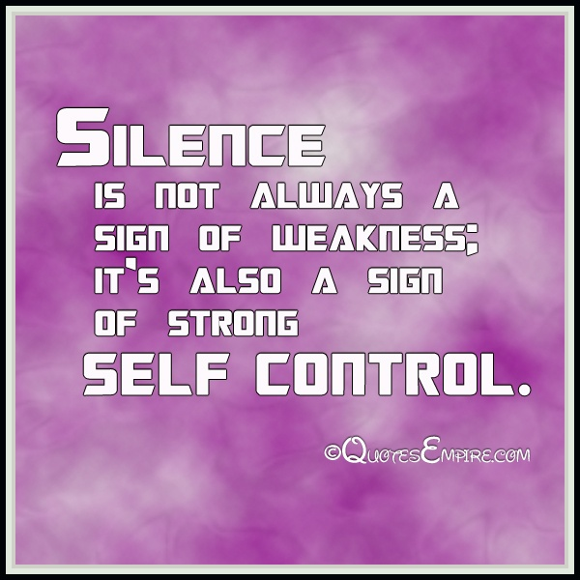
Notes:
SLIDE …Self Control !!! Sounds right up a Franciscan alley for work on inner poverty!!

Slide 19
Contemplating Duct Tape !
Notes:
For me, the desire to “fix it” , quickly no less !, was a hindrance, and I was seriously contemplating duct tape!! I figured I had walked down this path before, and wanted to share the lessons I learned. HA! First of all, I did not walk down their path. Second, Did I really learn those lessons? ( ask my kids on that one !!) .
How does one learn? Did the other need to learn anything at all?
You see where my logic was faulty.. It was all me-centered around my need to give advice and be validated as a wise woman.
However, I came to realize that really, the most effective solution to “fix the problem” was to allow the speaker the time to vent and be validated.
And, to allow the speaker to hear the Holy Spirit with their deepest core.

Slide 20
Obstacles to Empathic Listening:

Slide 21
Rushing in to problem solve and give advice
A ssumes the other needs it and wants it
D eprives the Holy Spirit from revealing what God wants to say
V ocalize too much
I nterferes in the other’s life
C alls attention to my “expertise”
E xpects that I will cure her/him
Examples of this sound like: “I think you should.”
“If I were you, I’d…”
“ There’s a great book about…”
Notes:
1st rushing in to problem solve and give advice. So What happens when we jump in to give advice? Read slide: note the should,, and I

Slide 22
Explaining it away
Examples of this:
“I would have called…”
She only said that because you…”
Notes:
Slide.. again note the emphasis on I, and the accusatory you ! And at the moment, the speaker really doesn’t want explanations for what they are going thru, they just need a listening ear.

Slide 23
Correcting it
Examples of this:
“That’s not how it happened…?” “But, you’re the one who…”, “Wait! I never said that!”
Notes:
Slide.. Note, this is not checking for accuracy,, rather the listener sounds very defensive and in so doing shuts down the speaker from really sharing their emotions.

Slide 24
Overly Consoling
Examples of this:
“It wasn’t your fault.”
“ You did the best you could.”
“ It could’ve been a lot worse.”
Notes:
Slide … Use your judgement here … there’s a fine line between empathy and overly placating. Pray for Holy Wisdom !!!

Slide 25
Telling a story
Examples of:
“ That reminds me of the time…”
“ I know how you feel.”
“That happened to me when I …”
Notes:
Slide… The speaker, at this time is not concerned about your life’s stories, at this time. And note where the emphasis is placed! On I, Me.
There may be another time for sharing stories, but not this holy and blest time between speaker and listener.

Slide 26
Shutting down feelings
Examples of this:
“ Cheer up!”
“ Don’t be so mad.”
“ Stop feeling sorry for yourself.”
Notes:
Slide… When we negate feelings, we shut down the speaker. They are meant to feel rejected. Feelings are neither good nor bad, they just are! And by acknowledging and reflecting back their feelings we affirm the person in the moment.

Slide 27
Sympathizing or commiserating
Examples of this:
“ Oh, you poor thing.”
“ How can people do that?”
Notes:
Slide… First off, the speaker is not a THING ! And asking a hypothetical question HOW,, is meaningless– The speaker is sharing her/his perception of what happened and how it made them feel. You can vent another time, to another trusted person, but in this moment, time and space you are hear to Listen to the speaker share their story!

Slide 28
Evaluating or Educating
Examples of this:
“You’re being unrealistic.”
“ The trouble with them is ..’
“If you weren’t so defensive..”
Notes:
Slide… the speaker doesn’t want to be evaluated, let alone negatively at this time, nor may they want “them” to be put down and be the Bad person.

Slide 29
One- upping
Examples of this:
“ That’s nothing.”
“ Listen to this!”
Notes:
Slide One- upping the story puts the listener into a contest as to whom has the most horrible story. This is not what Empathic listening is about!

Slide 30
Investigating or interrogating
Examples of this:
“ Why did you do that?”
“Why didn’t you call?
Notes:
Slide… Our purpose is to listen, not to judge. The two examples sound very judgmental in nature. Snoping around for additional facts may put up walls and block communication.

Slide 31
This being noted, I would again strongly suggest praying for Holy Wisdom and discernment as you listen to our young adults in this milieu. You may be the trusted individual who needs to hear a horrible story of abuse and/ or neglect. And you may want to follow up your time with the individual to request permission for professional help and counseling if necessary, as well as seek out the proper person for yourself for advice.
Notes:
Read slide…………. I would also like to note that Heather Cherniak has put together Listening Sessions for use with youth/ young adults in our parishes, or other settings, that addresses these issues in more detail.

Slide 32
WHAT HAPPENS IF ..
We warn, threaten or command—”You must”, “You have to”, “You will”, “You’d better, “ If you don’t, then”—the response of the speaker is usually one of fear or resistance.
Moralizing or preaching ( “you should”, “you ought to” , “it’s your responsibility”) creates guilt, hurt feelings, and causes one to defend their own position even more.
Jumping in with solutions implies that the person is not able to solve their own problems and prevents the person from thinking through a problem, considering alternative solutions and can create dependency.
Logical arguments provoke defensive positions and counter-arguments and may cause the person feel inferior and quit communicating
Probing interrogations may create more anxiousness and fear.
Finally, criticizing or blaming the other cuts off communication.

Slide 33
Notes:
God made us with two ears and one mouth. Twice the ability to listen for a reason. This being said, we also have a mouth to speak words. How do we use our words properly, to clarify, to convey our availability to problem solve with the other for a solutions or resolution if asked, or if we offer to help?

Slide 34
Notes:
Slide speaks for itself

Slide 35
Acknowledgement Responses:
“Uh-Uh”, “Go on”, “How about that”, “I see”, “Really”, “Sure”, “Sounds good”, “Great”, “You did”, “Eh?”
Use questions sparingly to clarify what the other person wants to communicate. Don’t jump in. Reflect back their feelings.
Some of what is shared may be uncomfortable for us as listeners.
When we do respond, repeat back in your own words a short summation to express to the other the essence of the content, feelings and meaning of what you heard.
Notes:
Read slide.

Slide 36
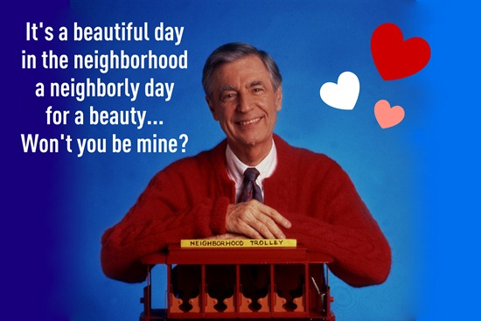
Notes:
Mr. Rogers was an example par excellence of a Good Listener! The movie, “ Won’t you be my neighbor? released in 2019 is a wonderful example of how his listening and genuine caring helped his friend to move past anger and start the journey towards forgiveness.
Keeping Fred Rogers in mind, here are some signs of a good listener:
A good listener says ‘yes’ to me with an open, accepting posture;
Puts aside his/her own’s concerns and needs, and allows me to stumble over my words.
Listens to the silences,
Does not presume to have the full truth,
Senses what I am feeling,
Steps inside my situation,
Judges nothing,
And receives me as I am.

Slide 37
A good listener says ‘yes’ to me with an open, accepting posture;
Puts aside his/her own’s concerns and needs;
Allows me to stumble over my words;
Listens to the silences;
Does not presume to have the full truth;
Senses what I am feeling;
Steps inside my situation;
Receives me as I am,
Judges nothing.
Notes:
Read slide Conversely, we are not being good listeners if we are interrupting, changing the subject, moving our body position a lot, ignoring questions, jumping to conclusions, or filling in the silences.
A good listener makes a commitment to listen to this person at this moment and does not act as though they are listening, or as though their heart is not in it. If it is not a good time for the listener, it is best to acknowledge that you are not free to pay attention at this moment, and add that would like to listen at a better time. For example: “ I can’t give you my attention now, but how about we talk after I finish x, y,or z, say at 1 PM? Focus on the speaker with soft eyes, and be mindful of the message that your own body positioning conveys. Note the speaker’s words, feelings, needs and perceptions was well as the information that is communicated. Register your own feeling and “hold it”. Offer back what you are hearing in your own words. Remember not to presume that what you are hearing is exactly what the speaker is trying to say. Keep listening until the speaker confirms that you have really understood.

Slide 38
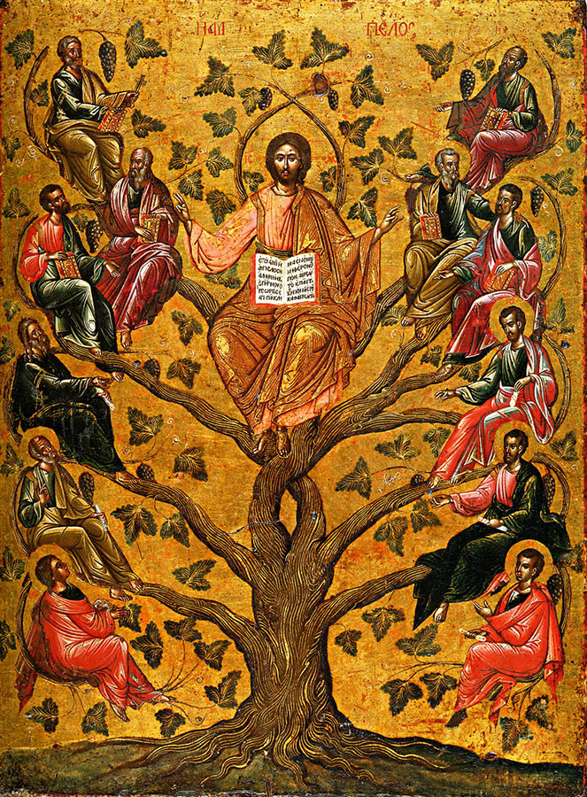
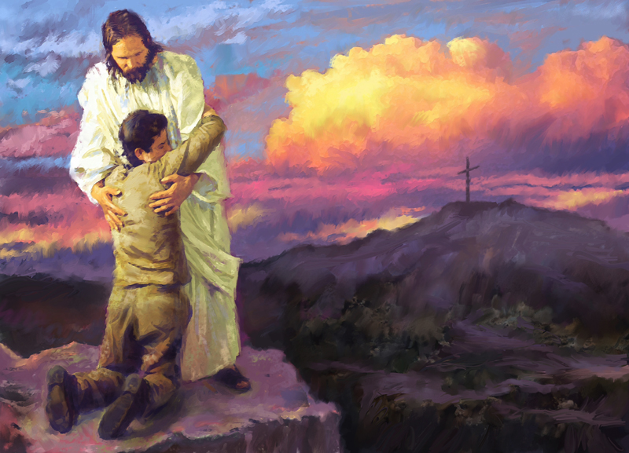
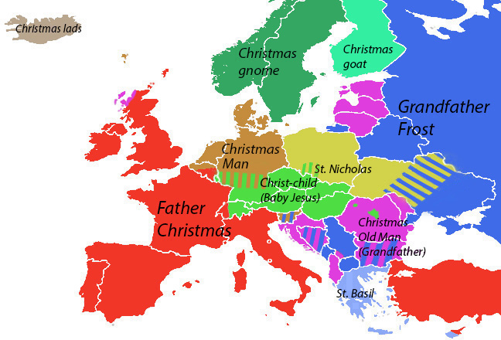
Notes:
This was quite a lot of talk about listening. Certainly not an easy skill to develop and I’ll admit that sometimes I still contemplate the duct tape solution for myself! However, I share all this material with you, because I believe that the better listeners we can become, we can then forge better relationships --- And, them more we can make Christ visible and present with those whom we are privileged to share the journey. For you Franciscans who have answered the call to journey with youth and young adults, I hope that you enter into this spirit of privilege and blessings for it is truly gifted time!

Slide 39
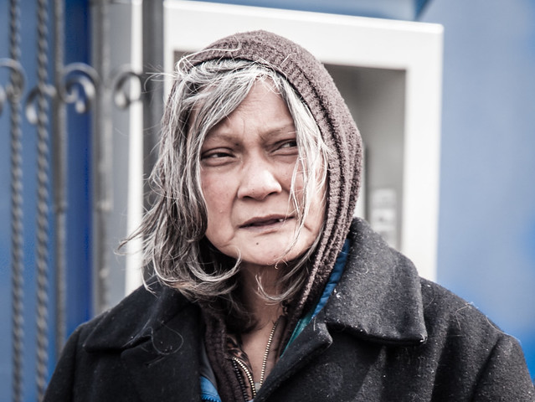
Notes:
In conclusion, I’d like to share this story taken from the 2019 Advent meditation guide Waiting in Joyful Hope: Daily Reflections for Advent and Christmas 2019-2020,written by Fr. Daniel Groody. It exemplifies the power of silent presence and active listening.
Fr. Groody was “ passing through Grand Central Station in NYC and noticed a woman sitting on the side of a wall and slumped over her knees. She had stringy gray hair and a blue faded jacket and looked like a lifeless shell. After grabbing two cups of coffee, I sat down next to her. “ How are your doing?” “ Fine”, she said defensively. “ How’s your day been?” “Good !” she said guardedly. “What’s new?” “Nothing!”
With those words our conversation ended, and it felt like an iron wall had come down between us that would not let out even a pinhole of emotional light. But I stayed beside her sipping my coffee and did not leave. After about fifteen minutes she turned to me and said, “ Who the hell are you anyway?” I took a sip from my cup and said, “I’m a priest, and I thought you needed a cup of coffee.” With that, something unexpected happened. She began to cry with such intensity that her tears could have flooded the floors of the whole station. Not wanting to interfere with words, I just sat with her in silence while she wept and sobbed. But when she calmed down, she told me her name was Sara. I then said, “Sara, if you could change one thing in the world today, what would you change?” Surprisingly she said, “If I could change one thing in the world today, I would change… my mind. I’ve been filled with such bitterness and hatred that I cannot forgive, but if I could, I would be a new person!”

Slide 40
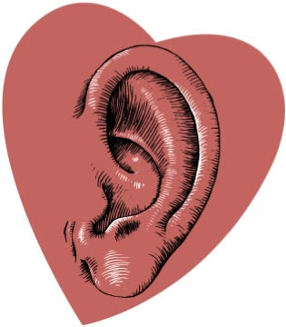
The power of a listening ear !!!
Notes:
Wasn’t that such a powerful story! Of course, as we scrutinize the story, Fr. Groody does lead in with some questions that while appearing innocuous, or normal to our colloquial conversation, to a homeless woman they presented as antagonistic. It was his silent presence that gave her the permission to be… to be present in her emotional vulnerability, and then to proceed to delve within to the heart of the matter.
Drawing the presentation to a close, I invite you to pray the poem Today I will Listen by Marva Shand-McIntosh

Slide 41
TODAY I WILL LISTEN by Marva Shand-McIntosh (This poem is on two slides)
TODAY I WILL LISTEN
Without interrupting
Without prejudging
Without second guessing
Without gazing
Without rehearsing
Without discounting
Without filtering
Without correcting
Without contradicting
TODAY I WILL JUST LISTEN
Notes:
If you are in a group, I suggest that everyone read the lines Today I will ( just ) Listen together, and that individuals take turns reading the remaining lines of the poem, slowly and with reverence. It is on two pages. May you each be blest both in listening and speaking.

Slide 42
TODAY I WILL LISTEN
With attention
With humility
With respect
With patience
With understanding
With awe
With gladness
With empathy
With warmth
With gratitude
With reverence
TODAY I WILL JUST LISTEN.
Amen !

